Slide 1

CUSTOMER CHURN PREDICTION USING SMOTE-EEN
SRM Institute of Science and Technology,
Ramapuram Campus, Chennai-89
DEPARTMENT OF COMPUTER SCIENCE AND ENGINEERING
Batch No: 1
DETAILS OF THE PROJECT MEMBERS
SRINAVAVENKATARAGHAVEENDRA (RA1911003020566)
VISHNU PRADEEP (RA1911003020587)
T. ROHIT VISHNU TEJA GUPTA (RA1911003020573)
SUPERVISOR DETAILS
Dr. R. RAMYA, AP/CSE

Slide 2
OBJECTIVE
The objective of this project is as follows:
To identify factors affecting the customer churn
To generate the pattern from large set of data of customers for prediction for churn around the world in any Index
To predict an approximate confidence of the churn
To provide analysis to users through a web application

Slide 3
SCOPE
Conducting experiments with end users’ perspective, gathering their opinions on network, data normalization, preprocessing data sets, employing feature selection, eliminating class imbalance and missing values, replacing existing variables with derived variables improves the accuracy of churn prediction which assists Telecom industries to retain their customers more efficiently.
Comparatively, a smaller study was done on user’s perspective, taking into consideration their quality of experience. In fact, no study was done taking into consideration only user’s data volumes. Estimation of Quality of Experience by finding relationships between QoE and traffic characteristics could help the service providers to continuously monitor the user satisfaction level, react timely and appropriately to rectify the performance problems and reduce the churn.

Slide 4
ABSTRACT
Customer churn detection is one of the most crucial research areas that the organization must address in the telecommunications industry in order to retain existing clients. Churn is the term for customer attrition brought on by competitors' departing offerings or perhaps by network problems. Customers often have a tendency to abandon their service subscriptions in these kinds of circumstances. Because it affects both the company's future revenue and the length of service, the churn rate has a significant impact on the lifetime value of the client. The corporations are searching for a model that can forecast client attrition because it has a direct impact on the industry's revenue. The model created in this study makes use of machine learning methods.
We are able to identify the consumers who are most likely to terminate their subscription by applying machine learning techniques. With the help of this, we can provide them with better services and lower the churn rate. These business models assist telecom services in becoming lucrative. We utilized Decision Trees, Random Forests, and SMOTE - EEN (Synthetic Minority Over-sampling Technique - Edited Nearest Neighbors

Slide 5
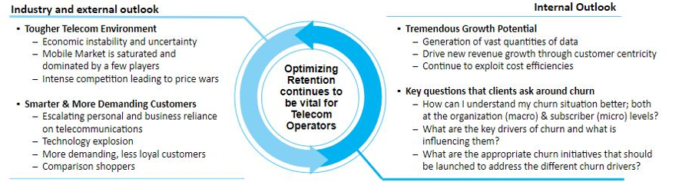
INTRODUCTION
Operators are losing share in today’s competitive market
Need to Manage Churn:
Churn is the key driver of EBITDA margin and an industry-wide challenge
A churned customer provides less or zero revenue and increases the competitor’s market share
Increase acquisition cost for the service provider if the customer churned to competitor. It costs 5X to acquire new subscriber as to retain an existing one

Slide 6
SYSTEM REQUIREMENTS
Hardware Requirements:
PC, 3GB RAM Minimum, 50GB Space required, Processor i3.
Software Requirements:
Windows 10 or advanced, Any PYTHON IDE, CMD to install python modules

Slide 7
Literature survey - Paper 1
Title : Integrated Churn Prediction and Customer Segmentation Framework for Telco
Year : 2021
Authors : SHULI WU, WEI-CHUEN YAU, et all
Inference: This research makes three important contributions. First, it is one of the few studies to consider both churn prediction and customer segmentation in the telco industry. Second, it uses Bayesian Analysis to conduct factor analysis, which links churn prediction to customer segmentation more effectively. Third, it provides operators with the overall probability of churning for each cluster, allowing them to better understand the churning situation of each cluster.

Slide 8
Literature survey - Paper 2
Title : Customer churn prediction system: A machine learning approach
Authors: Lalwani, P.; Mishra, M.K.; Chadha, J.S.; Sethi, P
Year : 2022
Inference: The proposed methodology consists of six phases. In the first two phases, data pre-processing and feature analysis are performed. In the third phase, feature selection is taken into consideration using the gravitational search algorithm. Next, the data is split into two parts train and test set in the ratio of 80% and 20% respectively. Boosting and ensemble techniques are also applied to see the effect on accuracy of models. In addition, K-fold cross validation is used over the train set for hyperparameter tuning and to prevent overfitting of models. Finally, the results on the test set are evaluated using the confusion matrix and AUC curve. It was found that Adaboost and XGboost Classifier give the highest accuracy of 81.71% and 80.8% respectively. The highest AUC score of 84% is achieved by both Adaboost and XGBoost Classifiers.

Slide 9
Literature survey - Paper 3
Title : Customer Churn Prediction in Telecommunication Industry Using Decision Tree and Artificial Neural Network Algorithms.
Authors: Arowolo, M.O.; Abdulsalam, S.O.; Saheed, Y.K.; Afolayan, J.O
Year : 2022
Inference: The purpose of this study is to use machine learning procedures on a telecom churn dataset, with the intention of improving feature selection accuracy. To do this, we will be using the Relief-F algorithm. This algorithm is designed to pick out related features from large datasets. To test the performance of our model, we will be using the CART and ANN classification methods. The accuracy of our predictions shows that the ANN classifier is more accurate than the CART classifier, with a 93.88% predictive capacity compared to the 91.60% of the CART classifier.

Slide 10
Literature survey - Paper 4
Title: Experimental analysis of hyperparameters for deep learning-based churn prediction in the banking sector
Authors: Domingos, E.; Ojeme, B.; Daramola, O.
Year : 2021
Inference: In this study, the effects of different configurations of hyperparameters when a DNN was used for churn prediction in the banking sector compared to when an MLP was used and explored. The DNN performed better than the MLP when it was configured with a rectifier function in the hidden layers and a sigmoid on the output layer. The batch size had a significant influence on the performance of the DNN in the sense that the performance dropped as the batch size got closer to the test set data..

Slide 11
Literature survey - Paper 5
Title : Explainable AI for Cheating Detection and Churn Prediction in Online Games
Authors: Xiong, Y.; Tao, J.; Zhao, S.; Wu, R.; Shen et all
Year : 2022
Inference: Online gaming is a huge industry that employs millions of people worldwide. However, the use of AI in online gaming has hindered its development due to the lack of explainability of black-box models. A GXAI workflow that combines the strong expressiveness of multi-view data sources and the clear transparency of multi-view black-box models is introduced. They presented four specific classifiers and explainers in the character portrait view, the behavior sequence view, the client image view, and the social graph view. Experiments conducted on real-world datasets for game cheating detection and player churn prediction show the accuracy of the classification and the rationality of explanation. We also discover and present numerous interesting and valuable findings from the individual, local and global explanations. This paper also implemented and deployed three practical applications including evidence and reason generation, model debugging and testing, and model compression and comparison in NetEase Games and have received quite positive reviews from user studies.

Slide 12
Literature survey - Paper 6
Title : A Data-Driven Approach to Improve Customer Churn Prediction Based on Telecom Customer Segmentation.
Authors: Zhang, T.; Moro, S.; Ramos, R.F
Year : 2022
Inference: This study uses a discriminant model and a logistic regression model to predict telecom customer churn. The results of the study will help telecom managers improve customer retention rates. Additionally, the findings will help companies reduce costs and optimize their budgets. According to the results of this paper, the recommendations are for telecom companies to decrease their monthly fixed costs and local costs to increase the possibility of retaining their telecom customers. Additionally, the managers of telecom companies have already realized the value and importance of improving the service quality of the Internet, fixed-line, and CRBT products, as well as the call time for long-distant calls and the numbers of SMS and MMS in the telecom package, which has previously been proven to have a positive influence on telecom customers retention.

Slide 13
Literature survey - Paper 7
Title : Telecom churn prediction and used techniques, datasets and performance measures: A review
Authors: Jain, H.; Khunteta, A.; Srivastava, S
Year : 2021
Inference: The study found that machine learning techniques are mostly used for feature extraction and the establishment of a powerful technique for churn prediction, in particular for large datasets. They also found that accuracy is a good measure for performance, but measuring performance with only accuracy is not sufficient. Researchers also need to look at other performance measures, such as the confusion matrix, ROC, precision, and F-measure.

Slide 14
Literature survey - Paper 8
Title : K. Customer churn prediction in the telecommunication sector using a rough set approach.
Authors: Amin, A.; Anwar, S.; Adnan, A.; Nawaz, M.; Alawfi, K.; Hussain, A.; Huang, K
Year : 2017
Inference: This paper proposes a decision-making technique based on rough set theory to extract decision rules related to customer churn. The proposed approach effectively classifies churn from non-churn customers and predicts customers who will churn or may possibly churn in the future. Simulation experiments are carried out to evaluate the performance of the proposed technique using four rule-generation mechanisms. namely, the Exhaustive Algorithm (EA), Genetic Algorithm (GA), Covering Algorithm (CA) and the LEM2 algorithm (LA). Empirical results show that RST based on GA is the most efficient technique for extracting implicit knowledge in the form of decision rules from the publicly available, benchmark telecom dataset. Results show that the proposed technique offers a globally optimal solution for customer churn prediction when compared to state-of-the-art methods.

Slide 15
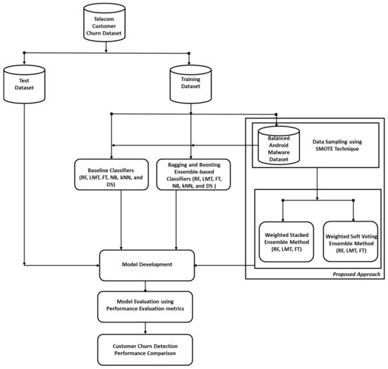
Architecture Diagram

Slide 16
ISSUES
Studies shows that reducing the data improves the accuracy of the decision tree. In some cases, data mining algorithms are used for customer prediction and historical analysis. But for using large dataset for churn prediction decision trees are inaccurate.
Overfitting of the data is present I.e.; Overfitting occurs when our machine learning model tries to cover all the data points or more than the required data points present in the given dataset. Because of this, the model starts caching noise and inaccurate values present in the dataset, and all these factors reduce the efficiency and accuracy of the model.

Slide 17
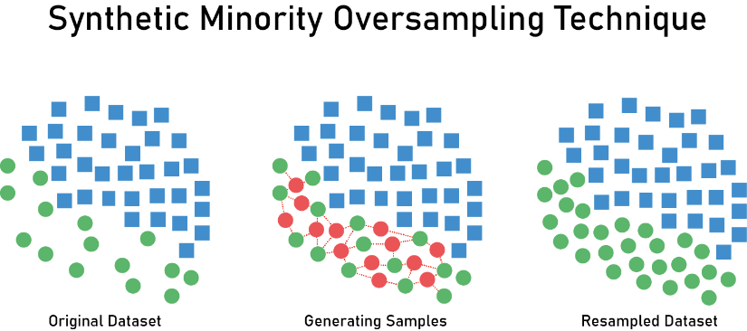


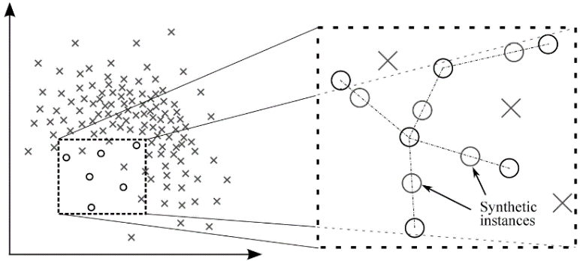
Algorithms Used
Decision Tree Classifier
Random Forest Classifier

Slide 18
Module 1 : EXPLORATORY DATA ANALYSIS
Step 1: Data Collection & Preprocessing:
Features {{ X(customerID,gender, SeniorCitizen, Partner, Dependents, tenure, PhoneService, MultipleLines, InternetService, OnlineSecurity, OnlineBackup, DeviceProtection, TechSupport, StreamingTV, StreamingMovies, Contract, PaperlessBilling, PaymentMethod, MonthlyCharges, TotalCharges), Y(Churn)}}
Step1.1 : Ratio of Churners/Non-churners
Step1.2 : Categorical analysis : Univariate analysis by Churn (All X by Y), Bivariate analysis, Multivariate analysis (n(X) with Y) -> Ex. Male Monthly SeniorCitizen by Churn is more
Step1.3 : Numerical analysis: Correlation Matrix -> MonthlyChargers, Tenure = 0.9 -> Pattern in dependency
Step1.4 : Gather insights form EDA

Slide 19
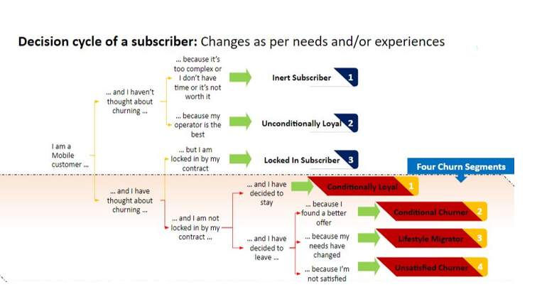
Module 2 : BUILDING MODELS
Step 2: Create variables and bifurcate training and testing data
Step 2.1: Build a Decision Tree Classifier – Gini Index
Step 2.2: Calculate the prediction score

Slide 20
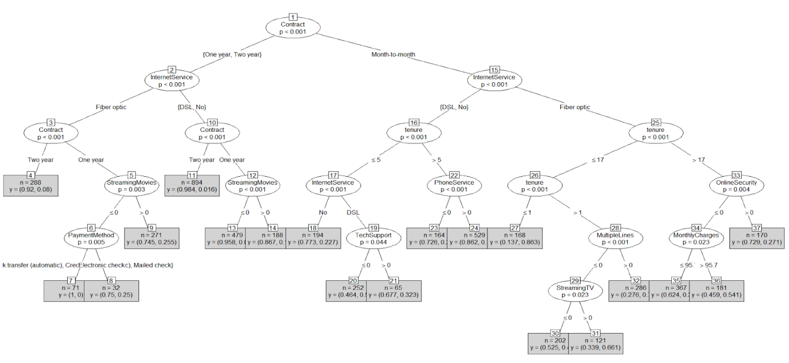
Module 2 : BUILDING MODELS
Step 2.3: Import Smote- EEN for Oversampling to increase accuracy
Step 2.4: Build a Random Forest Classifier – Gini Index
Step 2.5: Calculate the prediction score and save the model using pickle

Slide 21
Module 3 : CREATING A WEBAPP - DEPLOYMENT
Step 3: Initialize Flask, read the data and load the UI(HTML) page
Step 3.1: List the input queries
Step 3.2: Load the model
Step 3.3: Predict the churn
Step 3.4: Return the result with score
4-Oct-22
Department of Computer Science and Engineering
21

Slide 22
REFERENCES
Integrated Churn Prediction and Customer Segmentation Framework for Telco, Shuli Wu, Wei-Chuen Yau, et all, 2021
Customer churn prediction system: A machine learning approach, Lalwani, P; Mishra, M.K.; Chadha, J.S.; Sethi, P, 2022
Customer Churn Prediction in Telecommunication Industry Using Decision Tree and Artificial Neural Network Algorithms. Arowolo, M.O.; Abdulsalam, S.O.; Saheed, Y.K.; Afolayan, J.O 2022
Experimental analysis of hyperparameters for deep learning-based churn prediction in the banking sector, Domingos, E.; Ojeme, B.; Daramola, O. , 2021

